Slide 1
School of Geography and Earth Sciences McMaster University
Applied Spatial Statistics
Point Pattern Analysis III & IV

Slide 2
Last session:
Point Pattern Analysis I & II
Definitions
First and Second Order Properties
Visualizing Point Patterns
Exploring Point Patterns
Quadrat analysis
Kernel Estimation

Slide 3
This session:
Point Pattern Analysis III & IV
Exploring point patterns
Quadrat Analysis and Moving Windows
Kernel Estimation
Second Order Properties
Nearest Neighbor Analysis
The K Function

Slide 4
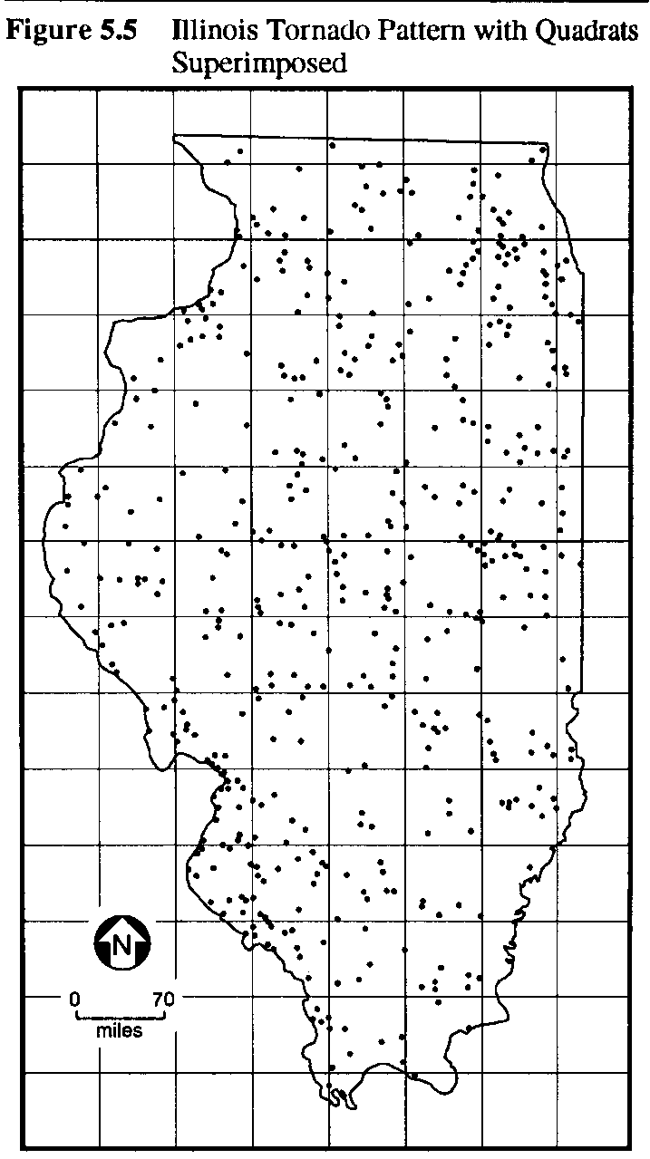
First order properties
Intensity –
Mean number of events per unit area at point s

Slide 5
First order properties
Quadrat analysis
(Moving windows)
Kernel estimation

Slide 6
Kernel Estimation
Smooth estimate of intensity
Number of events in R
Kernel
Homogeneity, isotropy:
s-s_{i} = h_{i} (distance between point s and event s_{i})

Slide 7
Kernel Estimation
Kernel function
if
otherwise

Slide 8
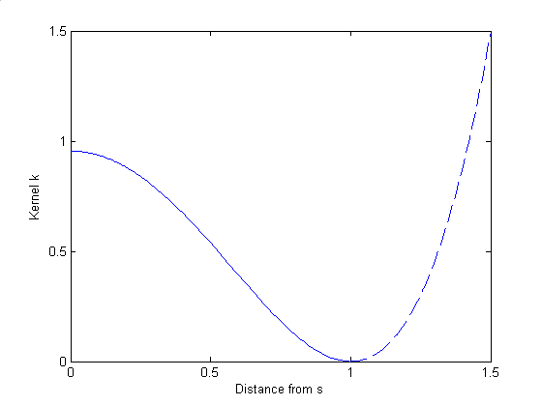
Kernel Estimation
τ = 1

Slide 9
Kernel Estimation
Kernel function
s
s_{i}
h_{i}
τ

Slide 10
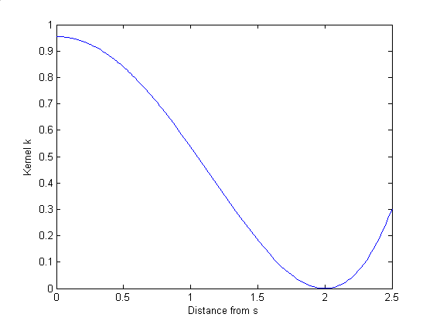
Kernel Estimation
τ = 2

Slide 11
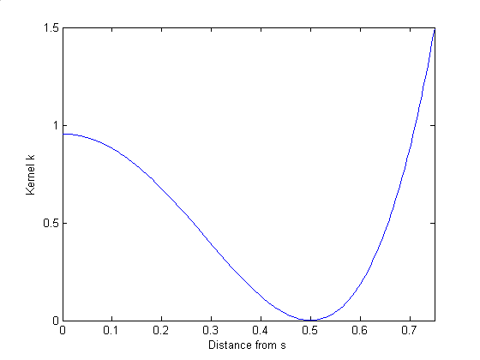
Kernel Estimation
τ = 0.5

Slide 12
Kernel Estimation

Slide 13
Kernel Estimation
Relative location of points within window
Edge effects
Window size

Slide 14
Kernel estimation
Edge effects?

Slide 15
Kernel estimation
Edge correction
Volume of kernel that is within R

Slide 16
Kernel estimation
Window size?
Visualization and exploration
Distribution of events

Slide 17
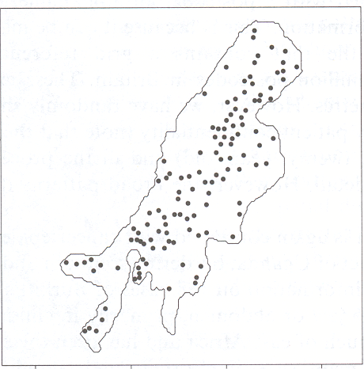
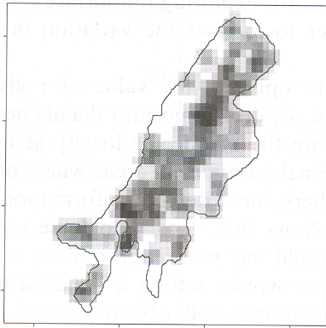
Kernel estimation
Example: Volcanic craters in Uganda (τ=100)

Slide 18
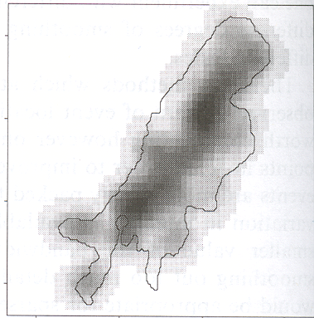
Kernel estimation
Example: Volcanic craters in Uganda (τ=220)

Slide 19
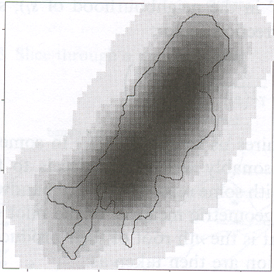
Kernel estimation
Example: Volcanic craters in Uganda (τ=500)

Slide 20
Kernel estimation
Window size (Visualization and exploration)
Rule of thumb (for R square unit)
(This must be scaled appropriately)

Slide 21
Kernel estimation
Window size

Slide 22
Kernel estimation
Adaptive kernel bandwidths

Slide 23
Second order properties
Small scale variation

Slide 24
Second order properties
Small scale variation

Slide 25
Second order properties
Small scale variation

Slide 26
Second order properties
Small scale variation

Slide 27
Second order properties
Nearest neighbor analysis
K functions

Slide 28
Nearest neighbor analysis
Event-Event nearest neighbor analysis
Applicable only to mapped point patterns
Point-Event nearest neighbor analysis
Applicable to mapped point patterns or for sampling purposes

Slide 29
Nearest neighbor analysis
Event-Event nearest neighbor analysis (distribution function)
w_{i} : Distance from event i to nearest neighbor
w : Distance
n : Number of events
Q: What is the range of possible values for ?

Slide 30
Nearest neighbor analysis
Event-Event nearest neighbor analysis

Slide 31
Nearest neighbor analysis
Event-Event nearest neighbor analysis (distribution function)
Q: What is the range of possible values for ?

Slide 32
Nearest neighbor analysis
Distribution function
1
0
Distance w

Slide 33
Nearest neighbor analysis
Clustering?

Slide 34
Nearest neighbor analysis
Clustering?
1
0
Distance w

Slide 35
Definitions: Patterns
Regularity?

Slide 36
Nearest neighbor analysis
Regularity?
1
0
Distance w

Slide 37
Nearest neighbor analysis
Sampled point pattern
Recorded
event
Unrecorded
event

Slide 38
Nearest neighbor analysis
Point-Event nearest neighbor analysis
x_{i} : Distance from point i to nearest event
x : Distance
m : Number of points

Slide 39
Nearest neighbor analysis
Point-Event nearest neighbor analysis
Event
Point

Slide 40
Nearest neighbor analysis
Clustering?

Slide 41
Nearest neighbor analysis
Clustering?
1
0
Distance x

Slide 42
Definitions: Patterns
Regularity?

Slide 43
Nearest neighbor analysis
Regularity?
1
0
Distance x

Slide 44
Nearest neighbor analysis
Check for random patterns
1
0
1

Slide 45
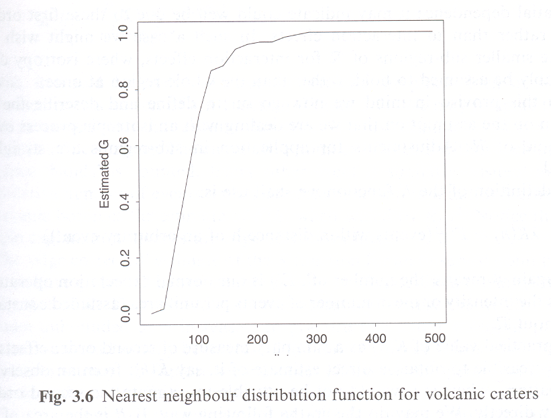
Nearest neighbor analysis
Example

Slide 46
Nearest neighbor analysis
Edge effects

Slide 47
Nearest neighbor analysis
Edge effects: remedial measures
Guard area

Slide 48
Nearest neighbor analysis
Edge effects: remedial measures
Toroidal correction

Slide 49
Nearest neighbor analysis
Event-Event nearest neighbor analysis with edge correction

Slide 50
Nearest neighbor analysis
Distance to nearest neighbor only
Small scale analysis – no indication of what happens at other scales

Slide 51
The K function
Various scales
Implicit assumptions
Homogeneity
Isotropy

Slide 52
The K function
λK(h)=
E(#(events within distance h of an arbitrary event))
λ : Intensity
R : Area of region R
I_{h} : Indicator function (1 if d_{ij}<h, 0 otherwise)

Slide 53
The K function
λ=n/R
w_{ij}= weight to correct for edge effects

Slide 54
The K function
Four events within distance 5 of event i

Slide 55
The K function
Four events within distance 5 of event i

Slide 56
The L function
If the point pattern is random:
K(h)=πh²
Under regularity:
K(h)<πh²
Under clustering:
K(h)>πh²

Slide 57
The L function
Compare the K function to the basic random condition

Slide 58
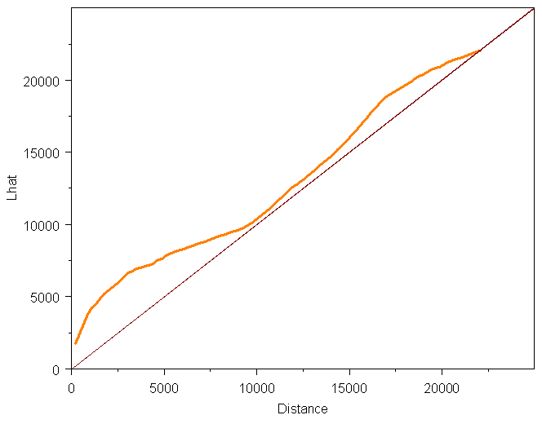
The L function
Example: The L function plotted

Slide 59
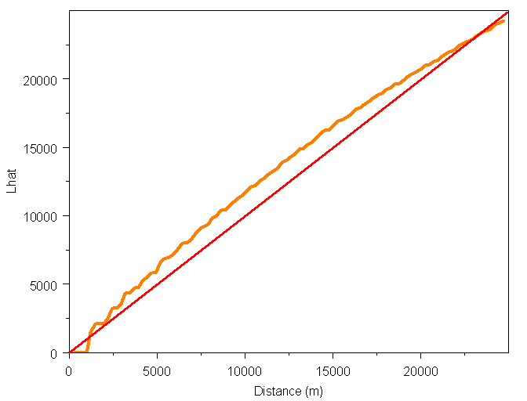
L-Function of Regular Pattern

Slide 60
Next …
Point Pattern V & VI: Simulation and Inference

